Slide 1
International Opportunities
University of Gävle

Slide 2
The International Office welcomes you to ….
BRITTA
BOJANA
Why you should Study Abroad
Opportunities
an exchange student
as an intern
20 minutes with questions at the end!
ANNA

Slide 3
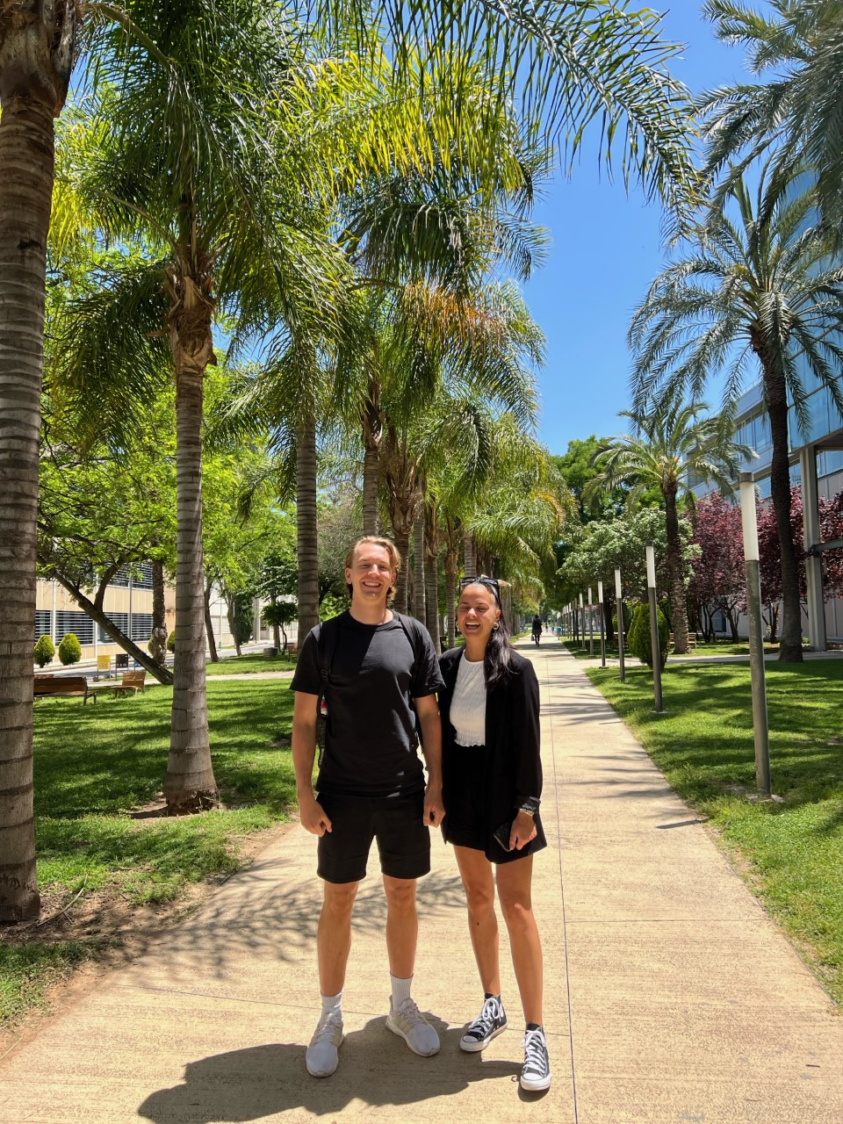
Why?
An experience for life – fun and adventure
Live/study/work in another culture
Discover new perspectives
Make new friends and contacts
Develop language skills
Gain a competitive advantage when looking for a job
Robin and Jenny in Valencia, Erasmus+ exchange!

Slide 4
Where do you want to go? What do you want to do? How long?

Slide 5
Erasmus + Studies
EU exchange student programme
We have partnerships with 83 universities in 18 EU countries
2-12 months
Courses are credited – traineeship as part of studies can be credited
No tuition fees
Scholarship between 400€ - 615€ / month
Extra funds for:
Green Travel – sustainable travel (train, bus, etc)
Students with physical, mental or health conditions
Students with children

Slide 6
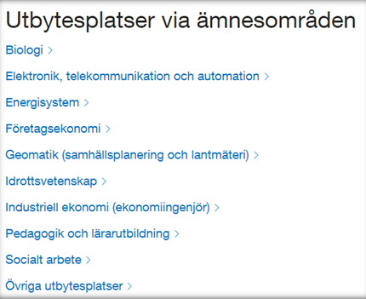
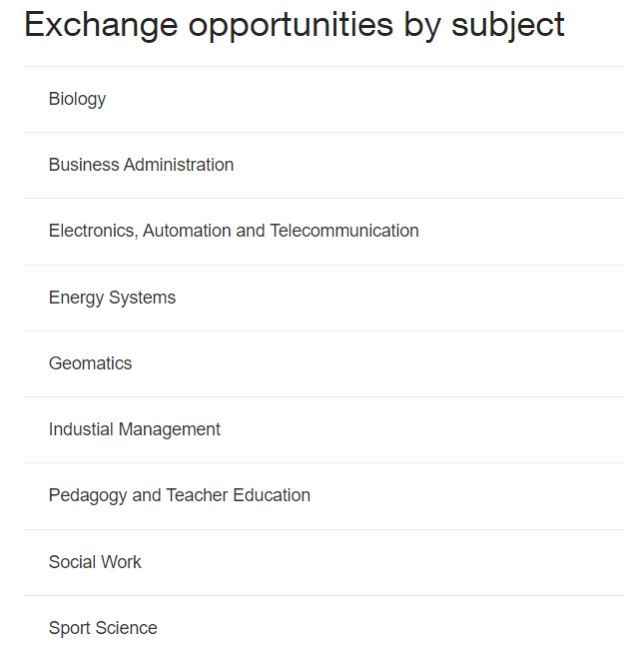
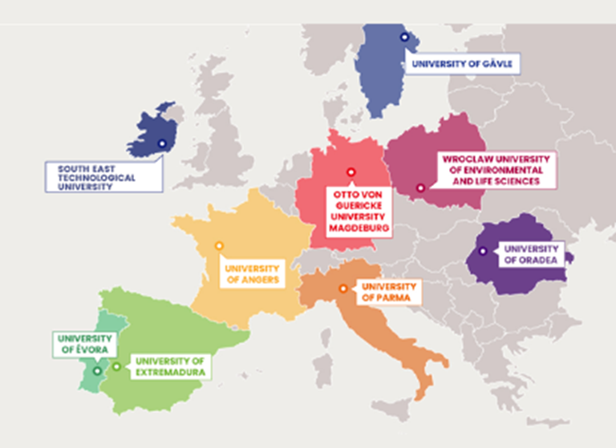
By programme/subject
Check out our new EU GREEN Partners!

Slide 7
Other possibilities
Bilateral exchange agreements
No scholarship funds
No tuition fees
Courses are credited
Examples: Canada (Geomatics), Japan, South Korea
”Free Mover” – on your own
Find country/city/university and apply
Responsible for all costs and credit
Get help from e.g. Study Abroad & Kilroy Education

Slide 8
Erasmus + Traineeship
Traineeship at any company, organisation related to your field*
Any EU country + Norway, Iceland, Serbia, Turkey, North Macadonia, etc
2-12 months* (apply before taking out your degree)
Scholarship between 550€ - 615€ / month*
Extra funds for e.g.:
Green Travel – sustainable travel (train, bus, etc)
Students with physical, mental or health conditions
Students with children

Slide 9
Contact Us!
Send us an email: studentsupport@hig.se
Visit our websites:
www.hig.se/utbytesstudier
https://hig.se/studyabroad
www.studera.nu → Studera utomlands

